Slide 1
NetGAN: Generating Graphs via Random Walks
Aleksandar Bojchevski, Oleksandr Shchur, Daniel Zugner, Stephan Gunnemann
Presenter: Dawei Zhou
Notes:
This paper is published on ICML this year.

Slide 2
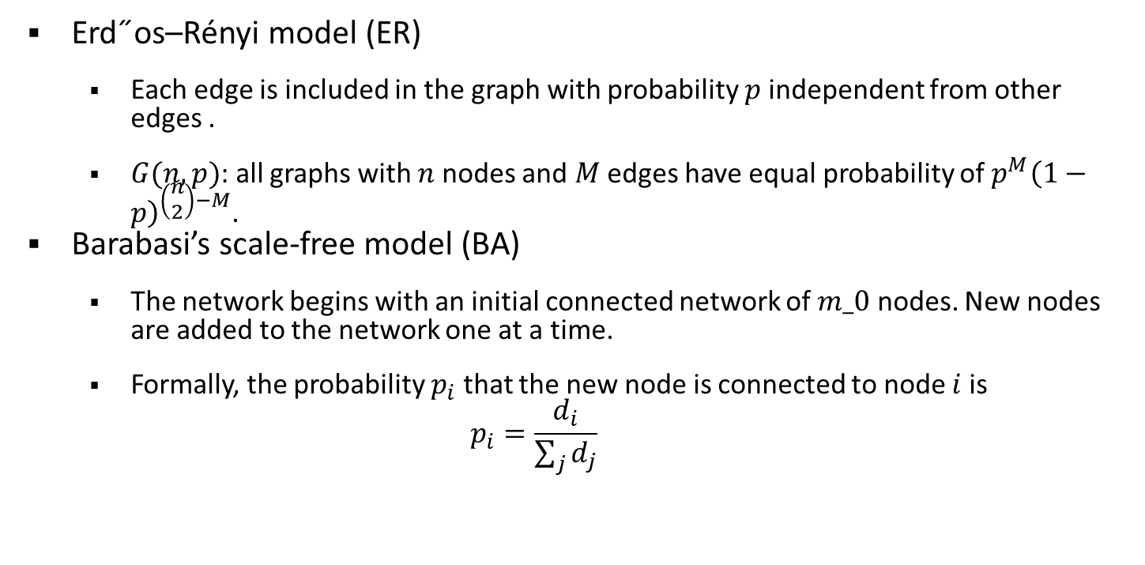
Random Graph Model
Erd˝os–Rényi model (ER)
Each edge is included in the graph with probability $p$ independent from other edges .
$G(n,p)$: all graphs with $n$ nodes and $M$ edges have equal probability of $p^{M}{\left(1−p\right)}^{\left(\begin{matrix}n \\ 2\end{matrix}\right)−M}$.
Barabasi’s scale-free model (BA)
The network begins with an initial connected network of $m_0$ nodes. New nodes are added to the network one at a time.
Formally, the probability $p_{i}$ that the new node is connected to node $i$ is
$$p_{i}=\frac{d_{i}}{\sum_{j}{d_{j}}}$$

Slide 3
Limitation of Random Graph Models
Limited to specific graph properties
Degree distribution
Edge density distribution
….
Can not preserve the rich context information
Structure role
Attributes
Graph dynamics

Slide 4
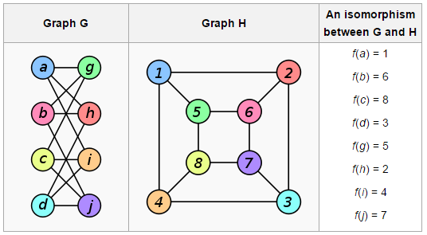
Deep Generative Model
GAN/VAE/Generative Moment Matching Network (GMMN)
Time series
Image/Video
Unique challenges for graphs: Graph Isomorphism Problem

Slide 5
Motivation
Goal: A graph generative model to mimic (large) real-world networks.
Quadratic complexity for previous methods which produce the entire adjacency matrix.
Differences from molecule generation.
Many small graphs v.s. one large graph.
Notes:
The goal of this paper is to learn a generative model for graphs to mimic large-scale real-world networks.
Previous methods on graph generation mostly focus on generating small graphs such as molecules. Their complexity is usually quadratic or even higher because they need to generate the whole adjacency matrix.
Also, compared with molecule generation, the input is only a large graph instead of many smaller ones. Thus most previous methods cannot be adapted for this setting.

Slide 6
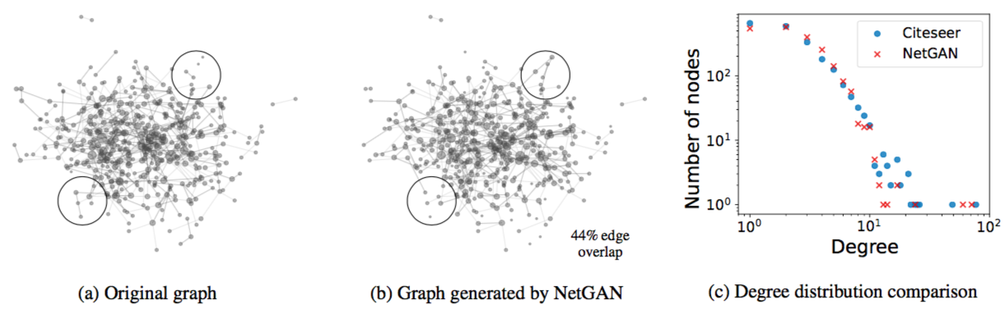
Example
Notes:
Figure (a) is a Subgraph of the CITESEER network and (b) is the respective subset of the graph generated by NetGAN. Both have similar structure but are not identical. (c) shows that the degree distributions of the two graphs are very close.

Slide 7
Challenges
Scalability: cannot generate the entire adjacency matrix.
Training: how to learn from a single graph?
Generalization: should not only memorize the network.
Solution: Generate random walks instead!
Notes:
Since we are supposed to generate a large graph, we can’t generate the entire adjacency matrix due to the scalability problem.
Also, it’s another challenge that how to learn from a single graph. In molecule generation, we usually have many molecules to train the model.
Since there is only one input graph, it is easy to memorize the graph. What we want is to learn the ability to generalize instead of generating the same input graph every time.
The authors propose a solution to generate random walks instead.

Slide 8
Advantages of Random Walks
Scalability: random walks only include the nonzero entries of adjacency matrix.
Training: sufficient training examples by random sampling.
Generalization: alleviate the overfitting problem by randomness.
Permutation Invariant etc.
Notes:
There are many benefits of random walks.
random walks only include the nonzero entries of A, thus efficiently exploit the sparsity of real-world graphs
We can generate sufficient… though we have only one graph.
Also, by random sampling, such uncertainty will exist in every batch of training data and thus alleviate the overfitting problem.
Permutation Invariant: make it easier to develop models

Slide 9
Model Framework
Step 1: Learn how to generate realistic random walks.
Step 2: Recover the graph from transition counts in generated random walks.
Notes:
Then the model can be divided into two steps.

Slide 10
Model Framework
Step 1: Learn how to generate realistic random walks.
Step 2: Recover the graph from transition counts in generated random walks.

Slide 11
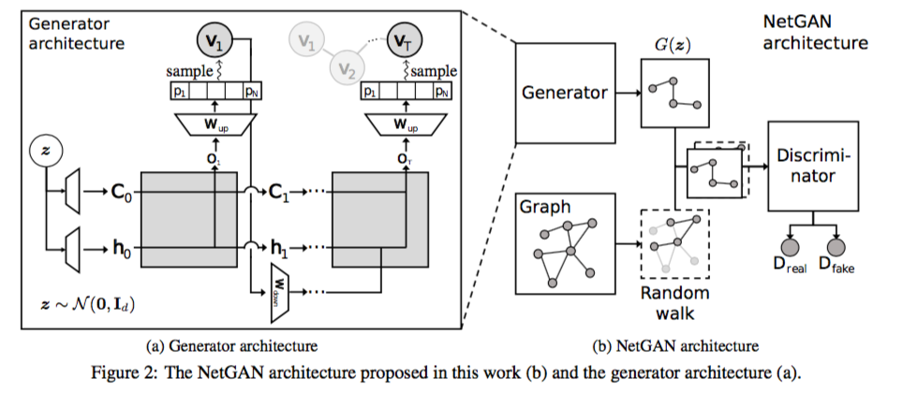
Overview
Notes:
Here’s the overview of NetGAN architecture.

Slide 12
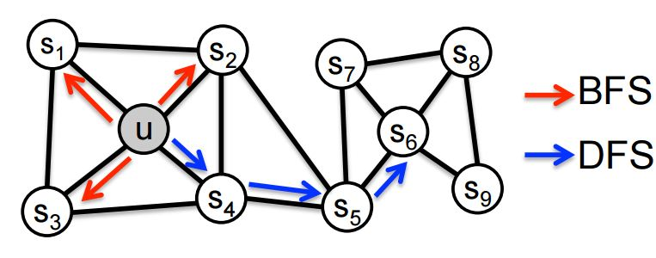
Training Set Generation
Biased random walk generation
BFS：Microscopic local information
DFS：Macroscopic global information
Grover and Leskovec, node2vec: Scalable Feature Learning for Networks. KDD 2016
Notes:
For generating the training set, they employ a biased parameterized random walk strategy. Generally, a BFS from a node will explore the local information and a depthFS will capture more global information.

Slide 13
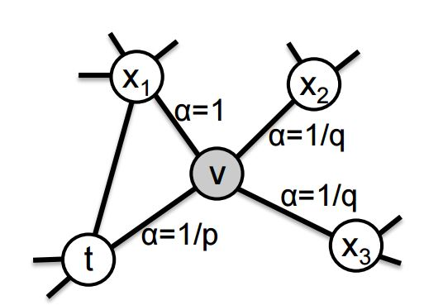
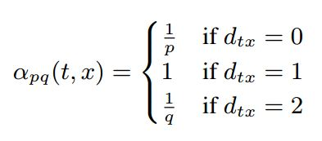
Training Set Generation
Parameterized Random Walk
Return parameter p，BFS
In-out parameter q，DFS
Notes:
The parameterized random walk has two hyperparameters p and q. A random walk walks from node t to v. So v is the current node and t is the last node. Parameter p will lead the RW to BFS while q will let the RW lean to DFS.
2nd order Markov process

Slide 14
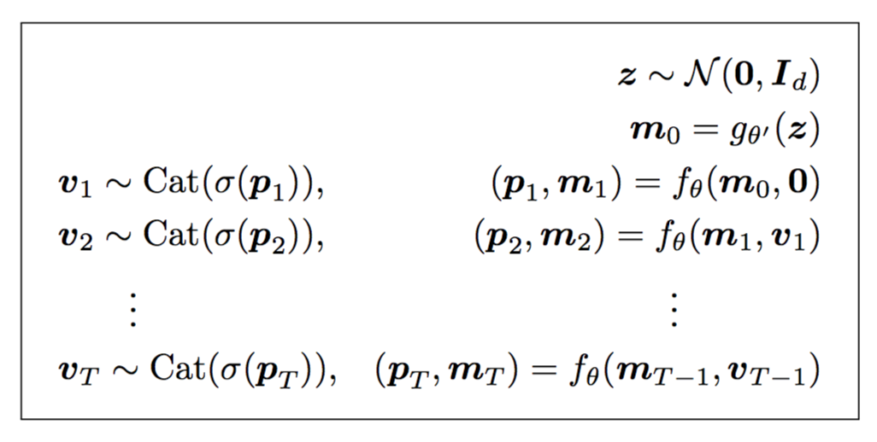
Generator
Notes:
This is the generation process of a random walk. We start from a random latent code z.

Slide 15
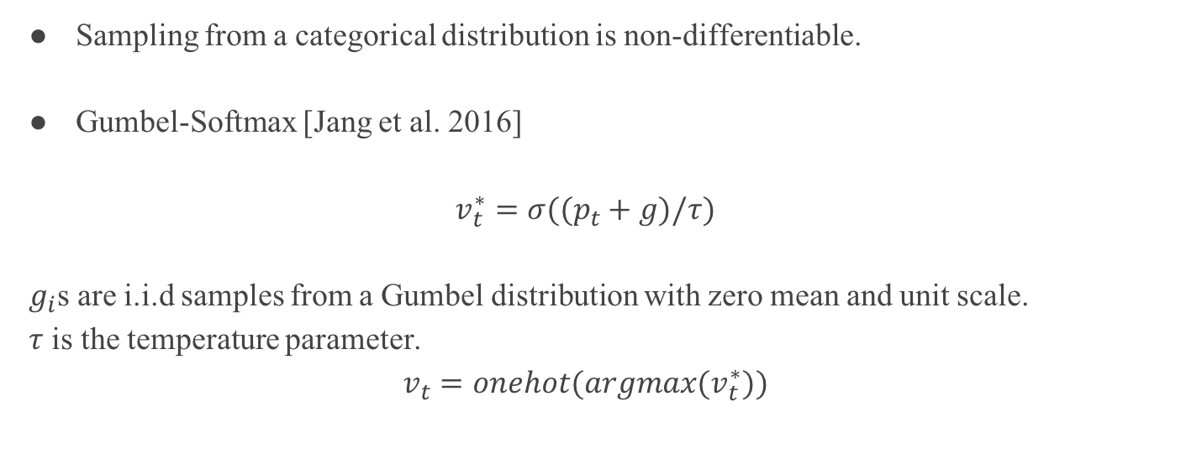
Categorical Reparameterization
Sampling from a categorical distribution is non-differentiable.
Gumbel-Softmax [Jang et al. 2016]
$$v_{t}^{∗}=σ((p_{t}+g)/τ)$$
$g_{i}$s are i.i.d samples from a Gumbel distribution with zero mean and unit scale.
$τ$ is the temperature parameter.
$$v_{t}=onehot(argmax(v_{t}^{∗}))$$
Notes:
Hoewever, sampling from a categorical distribution is a non-differentiable operation it blocks the flow of gradients
While the one-hot sample vt is passed as input to the next time step, during the backward pass the gradients will flow through the differentiable v∗t .

Slide 16
Discriminator
A standard LSTM architecture.
Outputs a single score that represents the probability of the random walk being real.

Slide 17
Model Framework
Step 1: Learn how to generate realistic random walks.
Step 2: Recover the graph from transition counts in generated random walks.

Slide 18
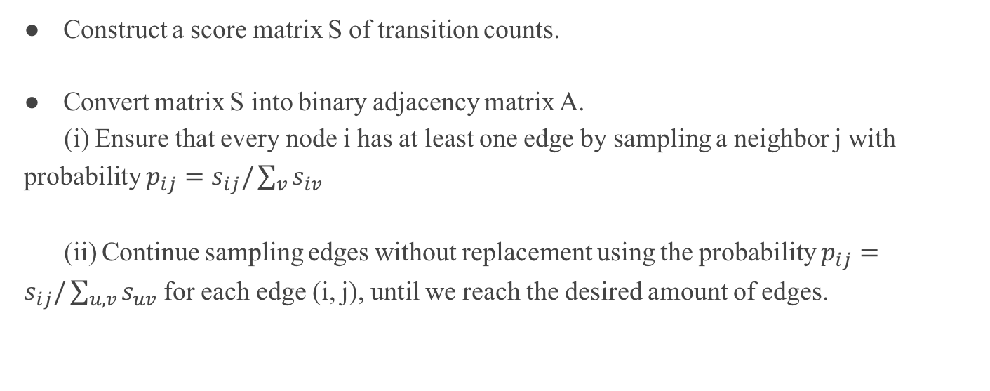
Assembling the Adjacency Matrix
Construct a score matrix S of transition counts.
Convert matrix S into binary adjacency matrix A.
(i) Ensure that every node i has at least one edge by sampling a neighbor j with probability $p_{ij}=s_{ij}/\sum_{v}{s_{iv}}$
(ii) Continue sampling edges without replacement using the probability $p_{ij}=s_{ij}/\sum_{u,v}{s_{uv}}$ for each edge (i, j), until we reach the desired amount of edges.
Notes:
In other words, we count how often an edge appears in the set of generated random walks

Slide 19
Other Details
Wasserstein GAN.
Early stopping strategy.
keep a sliding window of the random walks generated in the last 1,000 iterations and use them to construct a matrix S of transition counts.
VAL-CRITERION: Best performance of link prediction on validation set.
EO-CRITERION: Stops when we reach a user specified edge overlap with original graph..
Notes:
For other details, the authors use WGAN for training.
One thing important is to decide when to stop. In this paper, they keep… The transition counts can be seen as scores of edges and thus used for link prediction.

Slide 20
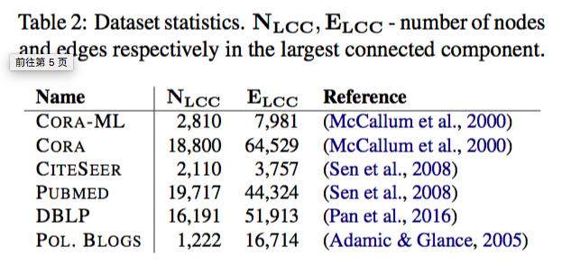
Experiments
Datasets

Slide 21
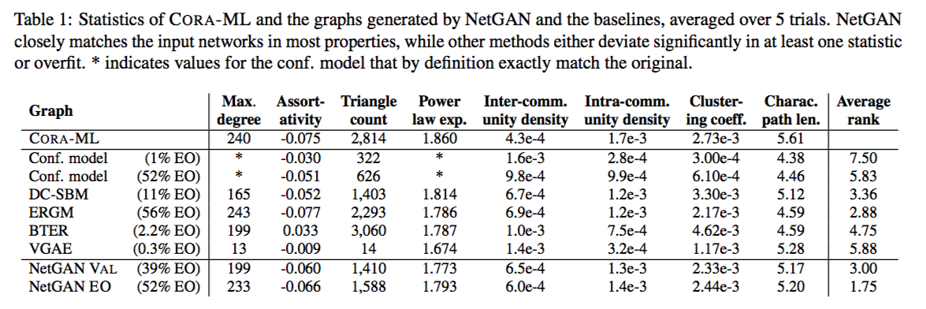
Graph Generation
Randomly hide 15% edges for parameter tuning.
Notes:
On graph generation task, we randomly remove 15% edges to tune the parameters.
This table shows the statistics of the original graph and the learned graph models. The rule is that the closer the better.
We use the average rank as the metric for evaluation.
Note that ERGM performs well in this task. But ERGM gives almost random results for link prediction task. This means ERGM simply memorize the input graph and lose the ability for generalization.

Slide 22
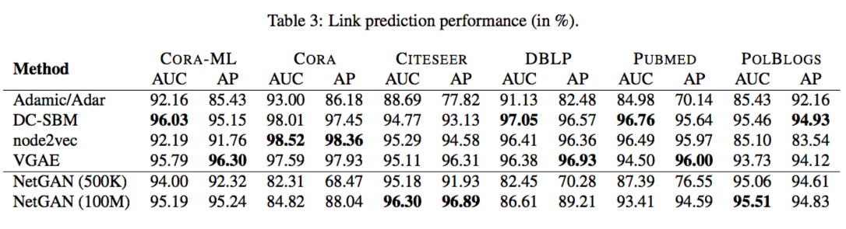
Link Prediction
Randomly hold out 10% edges for validation and 5% for test.
500K and 100M generated random walks.
Notes:
For link prediction task,…
NetGAN gives competitive results compared with several state-of-the-art methods. This task demonstrates the generalization ability of NetGAN.

Slide 23
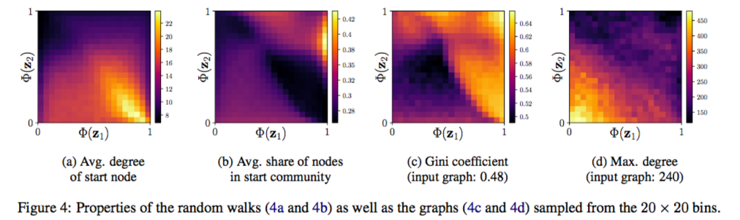
Latent Variable Interpolation
2-dimensional latent space divided into 20*20/10*10 subregions.
Notes:
Latent space interpolation is a good way to gain insight into what kind of structure the generator is able to capture.
For visualization, the model is trained over a 2-dimensional…
by interpolating in the latent space we can obtain graphs with smoothly changing properties.
The smooth transitions in the heatmaps provide evidence that our model learns to map specific parts of the latent space to specific properties of the graph.

Slide 24
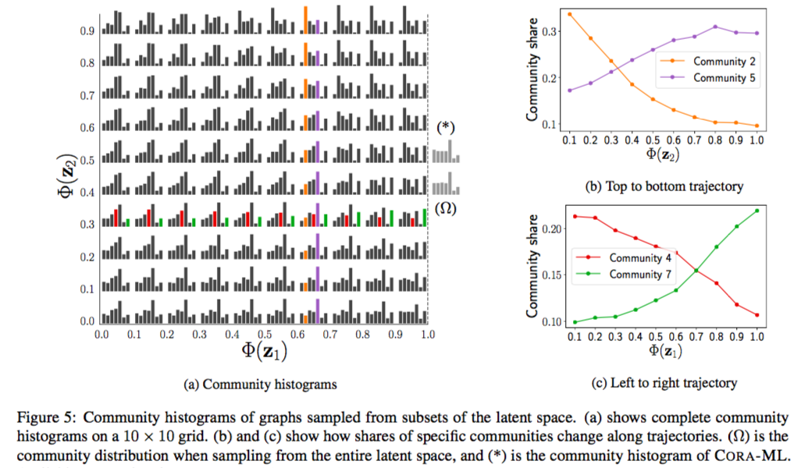
Latent Variable Interpolation
2-dimensional latent space divided into 20*20/10*10 subregions.
Notes:
This figure maps latent space to the generated graph properties in the community distribution histograms.

Slide 25
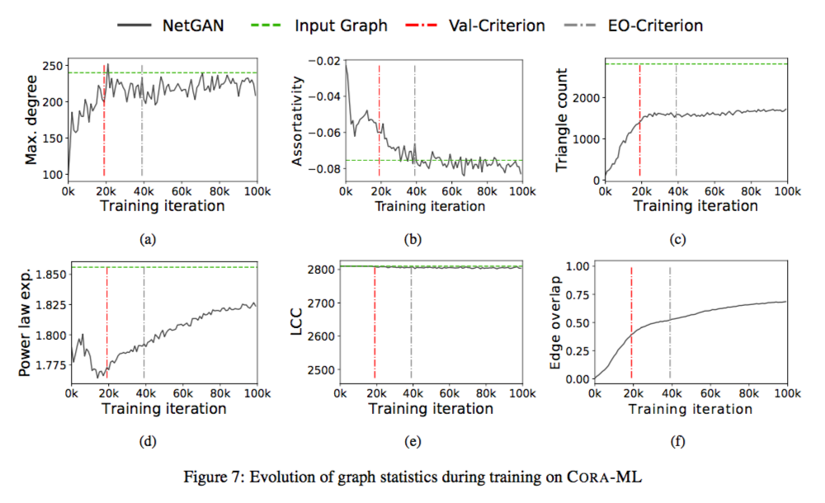
Evolution during Training
Notes:
This is the evolution of graph statistics during training. The edge overlap will go up to about 70%.

Slide 26
Conclusion
An implicit generative model for network data.
Capture important topological properties of complex networks, e.g. degree distribution, community structure…
Strong generalization properties demonstrated by its competitive link prediction performance.
Generate graphs with continuously varying characteristics using latent space interpolation.

Slide 27
References
NetGAN: Generating Graphs via Random Walks.
Categorical reparameterization with Gumbel-softmax. [Jang et al. 2016]

Slide 28
